Slide 1
Introduction to Machine Learning
Shahbaz Hassan
Lecturer

Slide 2
k-Nearest Neighbors

Slide 3
k-Nearest Neighbors
The k-NN algorithm is the simplest machine learning algorithm.
Building the model consists only of storing the training dataset.
To make a prediction for a new data point, the algorithm finds the closest data points in the training dataset. Its “nearest neighbors.”

Slide 4
k- Neighbors Classification
In its simplest version, the k-NN algorithm only considers exactly one nearest neighbor, which is the closest training data point to the point we want to make a prediction for.
The prediction is then simply the known output for this training point

Slide 5
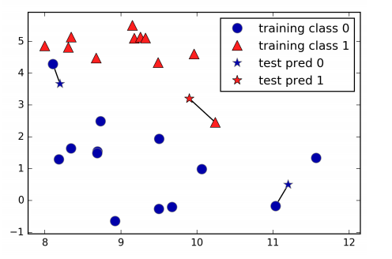
k- Neighbors Classification
mglearn.plots.plot_knn_classification(n_neighbors=1)

Slide 6
k- Neighbors Classification
Here, three new data points have been added, marked as Star.
For each of them, I marked the closest point in the training set. The prediction of the one-nearest-neighbor algorithm is the label of that point.
Instead of considering only the closest neighbor, we can also consider an arbitrary number, k, of neighbors. This is where the name of the k-nearest neighbors algorithm comes from

Slide 7
k- Neighbors Classification
When considering more than one neighbor, we use voting to assign a label. This means that for each test point, we count how many neighbors belong to class 0 and how many neighbors belong to class 1.
We then assign the class that is more frequent: in other words, the majority class among the k-nearest neighbors

Slide 8
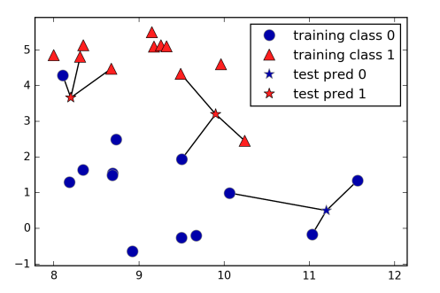
k- Neighbors Classification
mglearn.plots.plot_knn_classification(n_neighbors=3)

Slide 9
k- Neighbors Classification
You can see that the prediction for the new data point at the top left is not the same as the prediction when we used only one neighbor.
While this illustration is for a binary classification problem, this method can be applied to datasets with any number of classes.
For more classes, we count how many neighbors belong to each class and again predict the most common class.

Slide 10
KNN- Working

Slide 11
KNN
Step 1 − For implementing any algorithm, we need dataset. So during the first step of KNN, we must load the training as well as test data.
Step 2 − Next, we need to choose the value of K i.e. the nearest data points. K can be any integer.
Step 3 − For each point in the test data do the following

Slide 12
KNN
3.1 − Calculate the distance between test data and each row of training data with the help of any of the method namely: Euclidean, Manhattan or Hamming distance. The most commonly used method to calculate distance is Euclidean.
3.2 − Now, based on the distance value, sort them in ascending order.
3.3 − Next, it will choose the top K rows from the sorted array.
3.4 − Now, it will assign a class to the test point based on most frequent class of these rows.

Slide 13
KNN- Example
Task : Classify the given instance according to the classes of
Training data using KNN- Algorithm . The value of K = 3
Query = X= (Matric= 51, FSC = 69)
Matric % | FSC % | University Entry Test
55 | 60 | PASS
60 | 52 | FAIL
70 | 68 | PASS
55 | 85 | FAIL
87 | 56 | PASS
66 | 70 | FAIL

Slide 14
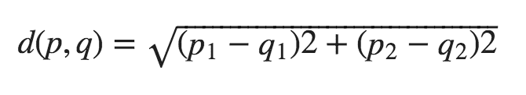
KNN- Example
Euclidean distance

Slide 15
KNN- Example
D1 = |51- 55|^2 + |69 – 60 |^2 = 97^1/2 = 9.84
D2 = |51-60|^2 + |69- 52|^2 = 370 ^1/2 = 19.23
D3= |51- 70|^2 + |69- 68|^2= 362 ^1/2 = 19.02
D4= |51- 55|^2 + |69- 85|^2 = 272^1/2 = 16.49
D5= |51- 87|^2 + |69-56|^2 = 1465^1/2= 38.27
D6 = |51- 66|^2 + |69 – 70|^2 = 226 ^1/2 = 15.03

Slide 16
KNN- Example
Now, based on the distance value, sort them in ascending order
D1, D6, D4, D3, D2, D5
9.84, 15.03, 16.49, 19.02, 19.23, 38.27
Next, it will choose the top K rows from the sorted array.
9.84, 15.03, 16.49 (D1, D6, D4)

Slide 17
KNN- Example
− Now, it will assign a class to the test point based on most frequent class of these rows.
D1 = Pass
D6= Fail
D4= Fail
Query = X= (Matric= 51, FSC = 69) = Fail

Slide 18
KNN- Summary

Slide 19
KNN- Summary
What is “K” in KNN algorithm?
K = Number of nearest neighbors you want to select to predict the class of a given item

Slide 20
How to Choose K in KNN
If K is small, then results might not be reliable because noise will have a higher influence on the result.
If K is large, then there will be a lot of processing which may adversely impact the performance of the algorithm. So, following is must be considered while choosing the value of K: a. K should be the square root of n (number of data points in training dataset)
b. K should be odd so that there are no ties. If square root is even, then add or subtract 1 to it.

Slide 21
Why KNN- Lazy Learner
When it gets the training data, it does not learn and make a model, it just stores the data
It does not derive any discriminative function from the training data
It uses the training data when it actually needs to do some prediction. So, KNN does not immediately learn a model, but delays the learning, that is why it is called lazy learner

Slide 22
K-NN Implementation

Slide 23
K-NN Implementation
Let’s assume that a hobby botanist is interested in distinguishing the species of some iris flowers that she has found. She has collected some measurements associated with each iris: the length and width of the petals and the length and width of the sepals, all measured in centimeters
She also has the measurements of some irises that have been previously identified by an expert botanist as belonging to the species setosa, versicolor, or virginica

Slide 24
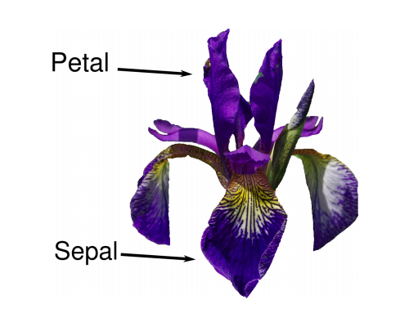
K-NN Implementation
Our goal is to build a machine learning model that can learn from the measurements of these irises whose species is known, so that we can predict the species for a new iris.

Slide 25
K-NN Implementation
Load the dataset
from sklearn.datasets import load_iris
iris_dataset = load_iris()
Check target names
print("Target names: {}".format(iris_dataset['target_names']))
Check the Features Name
print("Feature names: \n{}".format(iris_dataset['feature_names']))
Check the shape of the data
print("Shape of data: {}".format(iris_dataset['data'].shape))

Slide 26
K-NN Implementation
Split the data into training and test set.
from sklearn.model_selection import train_test_split X_train,
X_test, y_train, y_test = train_test_split( iris_dataset['data'], iris_dataset['target'], random_state=0)
Check the training data size
print("X_train shape: {}".format(X_train.shape))
Check the test data size
print("X_test shape: {}".format(X_test.shape))

Slide 27
K-NN Implementation
Build the model.
from sklearn.neighbors import KNeighborsClassifier
knn = KNeighborsClassifier(n_neighbors=1)
knn.fit(X_train, y_train)
Making Prediction
X_new = np.array([[5, 2.9, 1, 0.2]])
prediction = knn.predict(X_new)
print("Predicted target name: {}".format( iris_dataset['target_names'][prediction]))

Slide 28
K-NN Implementation
Model Evaluation.
print("Test set score: {:.2f}".format(knn.score(X_test, y_test))

